Slide 1

DJJJ TALK
Judah Csanyi – Team DJJJ
Encapsulation
February 4, 2025

Slide 2
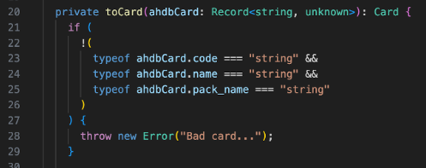






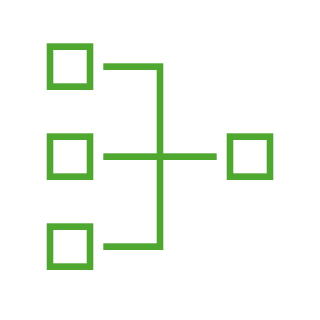
What Is Encapsulation?
Topics
Description:
Encapsulation is like putting data inside a secure box that has controlled access. This allow only specific methods access to the data, stopping unwanted changes or misuse.
Why use encapsulation? It protects your code from being internally modified by a user! You can keep sensitive data safe by controlling who can access it! Organizes your code into readable modulus without having to decode the whole program to understand what is being returned.
Boiling It Down
Improved Security
Data Protection
Code Modularity

Slide 3
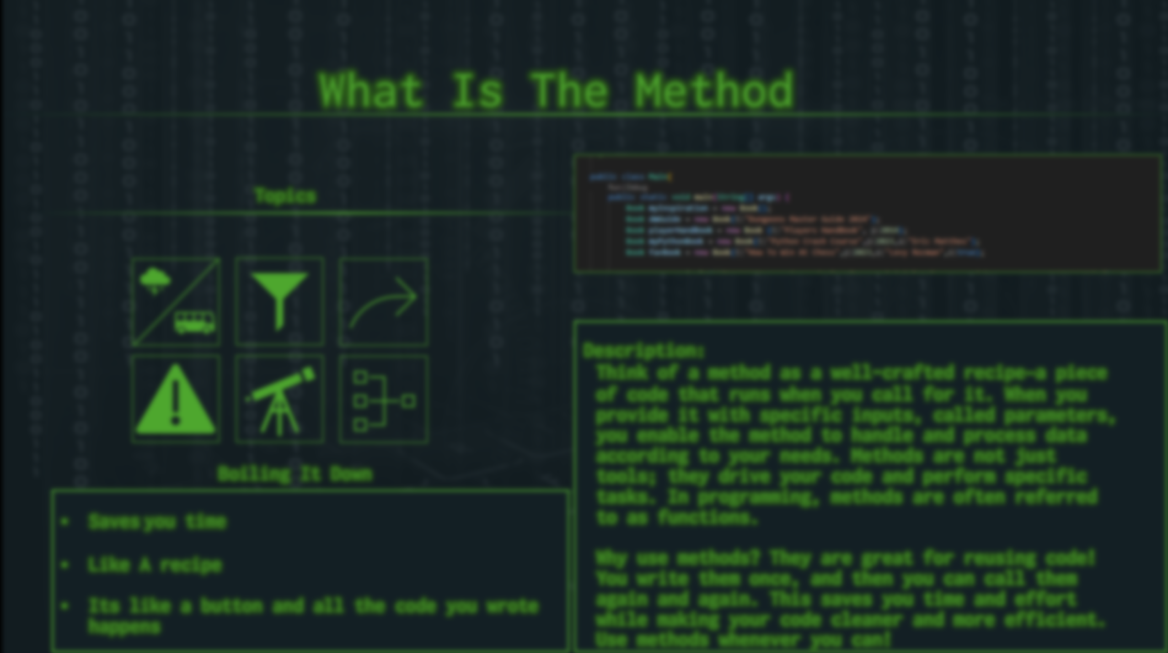
Private vs Public
Using the keyword private on data, means that it can only be accessed within the class. If you create an object, it is inaccessible.
By using the keyword public on data, you are saying that anyone and anything can access this.
Parameters
Static means that it can be accessed anywhere in the program
Public means the method can only be accessed by objects

Slide 4
Static Vs Public:
Getters & Setters
Return Values
Static means that it can be accessed anywhere in the program
Public means the method can only be accessed by objects
Getter: This is a public method within a class to access private data.
Setter: This also a public method used to rewrite private data.
Static means that it can be accessed anywhere in the program
Public means the method can only be accessed by objects

Slide 5
Parameters
How does it work
Method OverLoading
Static means that it can be accessed anywhere in the program
Public means the method can only be accessed by objects
Static means that it can be accessed anywhere in the program
Public means the method can only be accessed by objects
The programmer declares data that he doesn’t want any user to be able to access. So, he makes the data private.
If somebody want to see the or rewrite the data, they must use the public Getter and Setter methods preventing users from direct access

Slide 6
Questions

